Slide 1
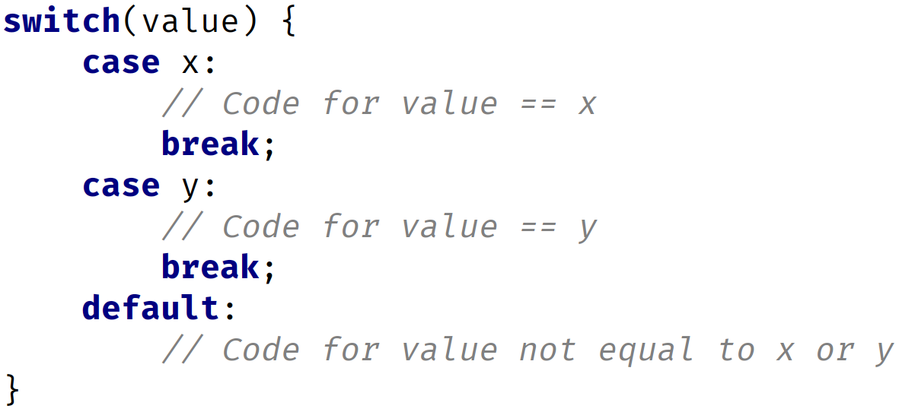

The switch statement
COMPLETE JAVA MASTERCLASS
The switch statement

Slide 2
Switch Value Types
Valid Switch Value Types
byte, short, int, char Byte, Short, Integer, Character String enum
Important: Cannot use long, float, double or boolean or their wrappers.
COMPLETE JAVA MASTERCLASS
The switch statement

Slide 3
Fall through in switch statement
Once a switch case label matches the switch variable, no more cases are checked.
Any code after the case label where there was a match found, will be executed, until a break statement, or the end of the switch statement occurs.
Without a break statement, execution will continue to fall through any case labels declared below the matching one, and execute each case's code.
COMPLETE JAVA MASTERCLASS
The switch statement

